Slide 1
The Need to be Proactive in Enhancing IoT Security and Privacy
Ann Cavoukian, Ph.D.
Distinguished Expert-in-Residence
Privacy by Design Centre of Excellence
Ryerson University
Canadian IoT Security Initiative
September 5th, 2018

Slide 2
Let’s Dispel The Myths

Slide 3
Privacy ≠ Secrecy
Privacy is not about having something to hide

Slide 4
Privacy = Control

Slide 5
Privacy = Personal Control
User control is critical
Freedom of choice
Informational self-determination
Context is key!

Slide 6
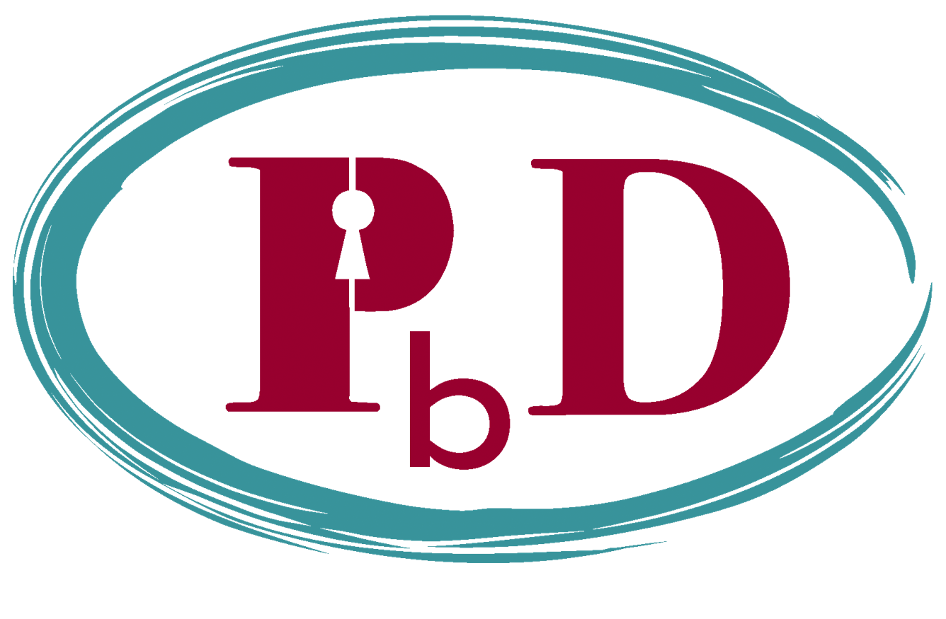
The Decade of Privacy by Design

Slide 7
Adoption of “Privacy by Design” as an International Standard
Landmark Resolution Passed to Preserve the Future of Privacy
By Anna Ohlden – October 29th 2010 - http://www.science20.com/newswire/landmark_resolution_passed_preserve_future_privacy
JERUSALEM, October 29, 2010 – A landmark Resolution by Ontario's Information and Privacy Commissioner, Dr. Ann Cavoukian, was approved by international Data Protection and Privacy Commissioners in Jerusalem today at their annual conference. The resolution recognizes Commissioner Cavoukian's concept of Privacy by Design - which ensures that privacy is embedded into new technologies and business practices, right from the outset - as an essential component of fundamental privacy protection.
Full Article:
http://www.science20.com/newswire/landmark_resolution_passed_preserve_future_privacy

Slide 8
Why We Need Privacy by Design
Most privacy breaches remain undetected – as regulators, we only see the tip of the iceberg
The majority of privacy breaches remain unchallenged, unregulated ... unknown
Regulatory compliance alone, is unsustainable as the sole model for ensuring the future of privacy

Slide 9
Privacy by Design: Proactive in 40 Languages!
English
French
German
Spanish
Italian
Czech
Dutch
Estonian
Hebrew
Hindi
Chinese
Japanese
Arabic
14.Armenian
15.Ukrainian
16.Korean
17.Russian
18.Romanian
19.Portuguese
20.Maltese
21.Greek
22.Macedonian
23.Bulgarian
24. Croatian
25.Polish
26.Turkish
27.Malaysian
28.Indonesian
29.Danish
30.Hungarian
31.Norwegian
32.Serbian
33.Lithuanian
34.Farsi
35.Finnish
36.Albanian
37.Catalan
38. Georgian
39. Urdu
40. Tamil
41. Afrikaans
(pending)

Slide 10
Positive-Sum Model: The Power of “And”
Change the paradigm
from a zero-sum to
a “positive-sum” model:
Create a win-win scenario,
not an either/or (vs.)
involving unnecessary trade-offs
and false dichotomies …
replace “vs.” with “and”

Slide 11
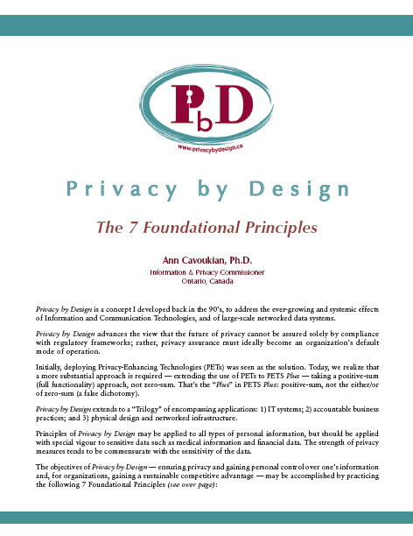
Privacy by Design: The 7 Foundational Principles
Proactive not Reactive: Preventative, not Remedial;
Privacy as the Default setting;
Privacy Embedded into Design;
Full Functionality: Positive-Sum, not Zero-Sum;
End-to-End Security: Full Lifecycle Protection;
Visibility and Transparency: Keep it Open;
Respect for User Privacy: Keep it User-Centric.
http://www.ryerson.ca/pbdce/papers/
http://www.ontla.on.ca/library/repository/mon/24005/301946.pdf

Slide 12
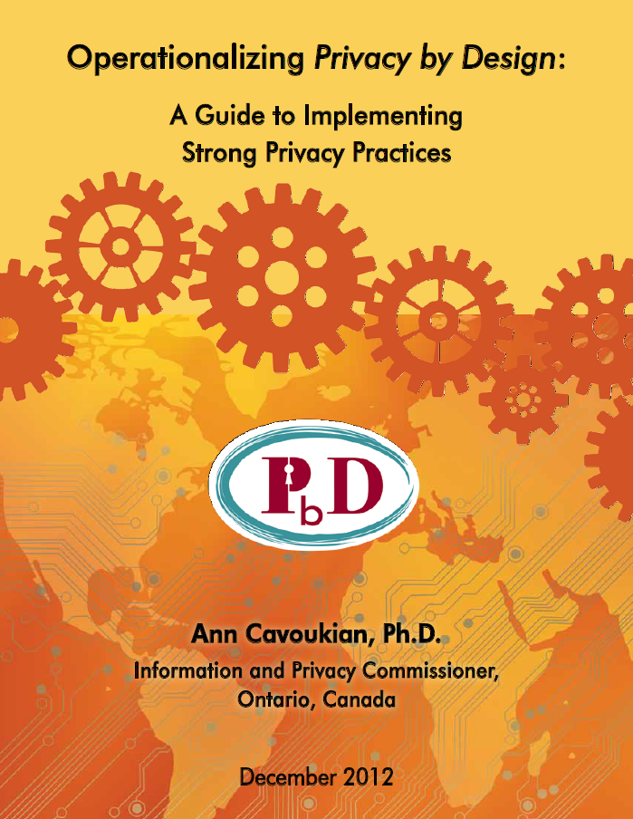
Operationalizing Privacy by Design
11 PbD Application Areas
CCTV/Surveillance cameras in mass transit systems;
Biometrics used in casinos and gaming facilities;
Smart Meters and the Smart Grid;
Mobile Communications;
Near Field Communications;
RFIDs and sensor technologies;
Redesigning IP Geolocation;
Remote Home Health Care;
Big Data and Data Analytics;
Privacy Protective Surveillance;
SmartData.
http://www.ryerson.ca/pbdce/papers/
http://www.ontla.on.ca/library/repository/mon/26012/320221.pdf

Slide 13
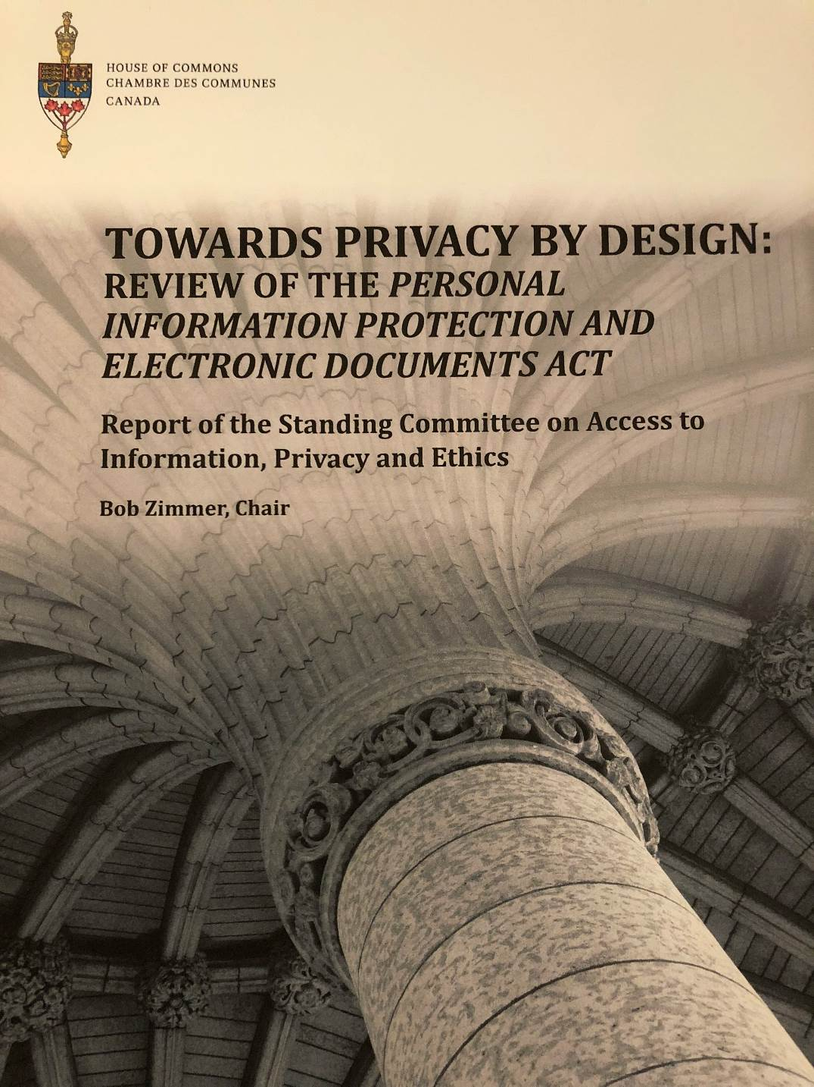
42nd Parliament, First Session
February, 2018
https://www.ourcommons.ca/Content/Committee/421/ETHI/Reports/RP9690701/ethirp12/ethirp12-e.pdf

Slide 14
GDPR General Data Protection Regulation
Strengthens and unifies data protection for individuals within the European Union
Gives citizens control over their personal data and simplifies regulations across the EU by unifying regulations
Proposed – January 25th 2012
Passed - December 17, 2015
Adoption – Spring 2016
Enforcement – Spring 2018

Slide 15
E.U. General Data Protection Regulation
The language of “Privacy/Data Protection by Design” and “Privacy as the Default” will now be appearing for the first time in a privacy statute, that was recently passed in the E.U.
Privacy by Design
Data Protection by Design
Privacy as the Default

Slide 16
The Similarities Between PbD and the GDPR
“Developed by former Ont. Information & Privacy Commissioner, Ann Cavoukian, Privacy by Design has had a large influence on security experts, policy markers, and regulators … The EU likes PbD … it’s referenced heavily in Article 25, and in many other places in the new regulation. It’s not too much of a stretch to say that if you implement PbD, you’ve mastered the GDPR.”
Information Age
September 24, 2015

Slide 17
Internet of Things (IoT)

Slide 18
Internet of Things: Three Broad Categories
1) Wearable Computing:
Everyday objects
i.e. Google glass, Apple watch, Nymi band
2) Quantified Self:
Record information about one’s habits, lifestyle and activities
i.e. Fitness and sleep trackers
3) Home Automation:
Computer controlled thermostats, light bulbs, smart meters, the smart grid, etc.

Slide 19
Internet of Things: Privacy Risks
Third party monitoring removes control of one’s information from the individual involved;
The nature of the devices may make it more difficult to obtain consent before data collection begins;
Specific instances of data collection may not seem important on their own, but when aggregated, they can create a comprehensive picture of a person that may be extremely harmful to the individuals involved, especially in the hands of unauthorized third parties.

Slide 20
EU Article 29 Working Party
Recommendations on the Internet of Things:
Make privacy the default setting … follow Privacy by Design;
Delete all raw data after processing;
Respect a user’s self-determination over their own data, and seek consent in a user-friendly way;
Be transparent about how a user’s data is being used;
When sensors are continuously collecting one’s personal data, remind users of this surveillance activity;
Ensure that data published to social platforms remain private, by default;
Users should not be penalized for failing to consent;
Data should be De-Identified, except when necessary.

Slide 21
Privacy Commissioners Declaration
36th Int’l Conference of Data Protection and Privacy Commissioners
on the Internet of Things
The value of Internet of Things (IoT) is not only in the devices, but in the services that arise from their use;
Connectivity is ubiquitous: it is the joint responsibility of all actors to ensure trust in connected systems : Transparency is Key;
Protection should begin from the moment data that is collected;
“Privacy by Design should be the key selling point of innovative technologies”
Strong, active and constructive debate is necessary to overcome the huge challenges presented by the developers of IoT.
-September, 2014
Mauritius

Slide 22
FTC expresses concerns over Mobile Health Apps
The U.S. Federal Trade Commission (FTC) has expressed concerns with the risks associated with the Health Information collected by the Apple Watch and HealthKit platform;
Data stored in mobile health apps are not covered by HIPAA;
FTC found that 12 mobile health and fitness app developers were sharing user information with 76 different parties;
The FTC would like to ensure that developers have the necessary safeguards to protect personal health information.

Slide 23
IoT Fears Relating to Tracking
“Earlier this year, Symantec Corp. analyzed a number of [wireless] wearable products and found that all hardware-based devices were 100% trackable.”
Anura Fernando
The Privacy Advisor

Slide 24
FTC and Privacy by Design
“Privacy and international issues will remain important parts of the FTC’s agenda. Privacy by Design is now a key pillar of our privacy work … as we work to champion the interests of consumers.”
In 2011, the FTC issued a report, under former Chairman, Jon Leibowitz, Protecting Consumer Privacy in an Era of Rapid Change, recommending 3 best practices – the first being that companies adopt a Privacy by Design approach by building privacy protections into their everyday business practices.
– Edith Ramirez
Chairwoman, U.S. Federal Trade Commission,
April 3, 2013.

Slide 25
Privacy and Security by Default
“With the personal data of millions potentially at stake, wearable manufacturers, whether their products are regulated as a medical device or not, should incorporate as a default standards-based privacy and security controls into their product infrastructures.”
Anura Fernando
The Privacy Advisor

Slide 26
FTC Report on IoT: The Internet of Things
Security Risks:
Unauthorized access to and Misuse of personal information;
Risks to personal safety;
Privacy Risks:
Making data, credit, insurance or employment decisions based on collected data;
Privacy and Security risks could undermine consumer confidence and impede technologies from meeting their full potential.

Slide 27
There is an Essential Need to Embed Privacy and Security into IoT and Mobile Devices, by Design

Slide 28
For IoT To Succeed, Engineers Must Build in Privacy
“Most engineers are still wrapped up in the basic infrastructure of IoT. As a result, more abstract ideas such as personal privacy can quickly fall by the wayside.”
-Cliff Ortmeyer,
Global Solutions Development
April 24, 2015

Slide 29
“The Perfect Storm of Privacy Exposure”
“Health and wellness apps that collect highly sensitive data and use third parties who are not sensitized to the appropriate handling of such data. . . make for the perfect storm of privacy exposure.”
-Steven Rosa,
Privacy Tech
April 6, 2015

Slide 30
Privacy is Good for Business !

Slide 31
The Bottom Line
Privacy should be viewed as a business issue, not a compliance issue
Think strategically and transform privacy into a competitive business advantage

Slide 32
Privacy by Design: The Global Privacy Framework
Dr. Cavoukian is offering the definitive
Privacy by Design Online Course
at Ryerson University
Should you wish to sign up for the Fall 2018 registration list, visit:
https://www.ryerson.ca/pbdce/privacy-by-design-chang-school-course/

Slide 33
Concluding Thoughts
Privacy and security risks are best managed by proactively embedding the principles of Privacy by Design – prevent the harm from arising – avoid the data breach;
Focus on prevention: It is much easier and far more cost-effective to build in privacy and security, up-front, rather than after-the-fact , reflecting the most ethical treatment of personal data;
Abandon zero-sum thinking – embrace doubly-enabling systems: Privacy and Security; Privacy and Data Utility;
Get smart – lead with Privacy – by Design, not privacy by chance or, worse, Privacy by Disaster!

Slide 34
Contact Information
Ann Cavoukian, Ph.D., LL.D (Hon.) M.S.M.
Distinguished Expert-in-Residence
Privacy by Design Centre of Excellence
Ryerson University
1 Dundas St. West, 25th Floor Toronto, Ontario M5G 1Z3
Phone: (416) 979-5000 ext. 553138
ann.cavoukian@ryerson.ca
ann.cavoukian@ryerson.ca
twitter.com/AnnCavoukian

